Slide 1
Windows Presentation Foundation

Slide 2
What are we going to do today?
Old vs. New
Windows Presentation Foundation
XP vs. Vista vs. 7
The MVC design pattern (again)
XAML
Silverlight, Windows Phone 7
See code examples

Slide 3
Old vs. New
In the beginning …. There was the Graphics Device Interface or GDI. GDI was responsible from drawing Windows, Menus, Basic shapes, Fonts, colors. Basically anything that was draw to the screen in Windows.
GDI is a C based API that was the center for all application development in Windows.

Slide 4
Old vs. New (Cont.)
GDI well perfectly suitable for Windowed applications could not be used for Games or applications with advanced graphics.
With the release of XP GDI was deprecated and GDI+ took its place.
GDI+ (Included on all MS OSs starting with XP) could handle modern graphic systems, such as vectored graphics, basic shaders, ARGB color palettes, support for new fonts etc.

Slide 5
Old vs. New (Cont.)
Think back to Windows 98 and Windows 2000 – compare the look and feel to that of Windows XP.
With the release of .NET the System.Drawing namespace was created to interact with GDI+

Slide 6
Old vs. New (cont.)
Windows Forms, the .NET wrapper for GDI+, became the defacto API for programmers to develop Windows applications.
.NET brought features such as Managed Code, Memory Management, simplified debugging, etc. to aid programmers during development. The biggest change was that unlike GDI application Windows Forms were rewritten to be Event Driven
While Windows Forms (or WinForms) were definitely advantageous to GDI they were still at a core level wrappers to very old C code whose usefulness and limitations were starting to show their age.

Slide 7
Old vs. New (Cont.)
In the meantime…A team of developers was working on a little known technology called DirectX.
DirectX is very sophisticated set of APIs used in game development on the Windows platform: Direct2D and Direct3D being the APIs used to interface with the graphics card at the hardware level for increased graphics performance.

Slide 8
Old vs. New (Cont.)
What if we could take the high powered graphics rendering employed by DirectX and use them to create WinForm-like applications?
Windows Presentation Foundation is born

Slide 9
Windows Presentation Foundation
Windows Presentation Foundation or WPF is a graphical subsystem for rendering interfaces in Windows
Unlike WinForms whose rendering technology was based off of GDI+, WPF utilizes the hardware level APIs that are DirectX

Slide 10
Windows Presentation Foundation (Cont.)
Features
Consistent programming model based on MVC
XML derived GUI layer known as XAML
Typography
Built in support for many file formats
2D and 3D rendering
Vector graphics
Built in Animation runtime
Event driven
Data binding
Digital Ink
Multi-touch capable
Interoperability with legacy with the Windows API and WinForm code

Slide 11
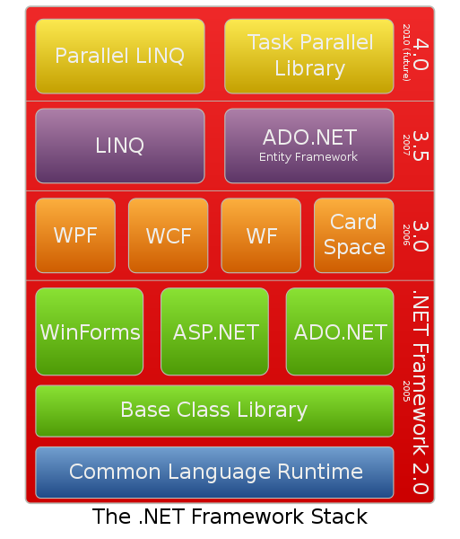
Windows Presentation Foundation (Cont.)
WPF Overview

Slide 12
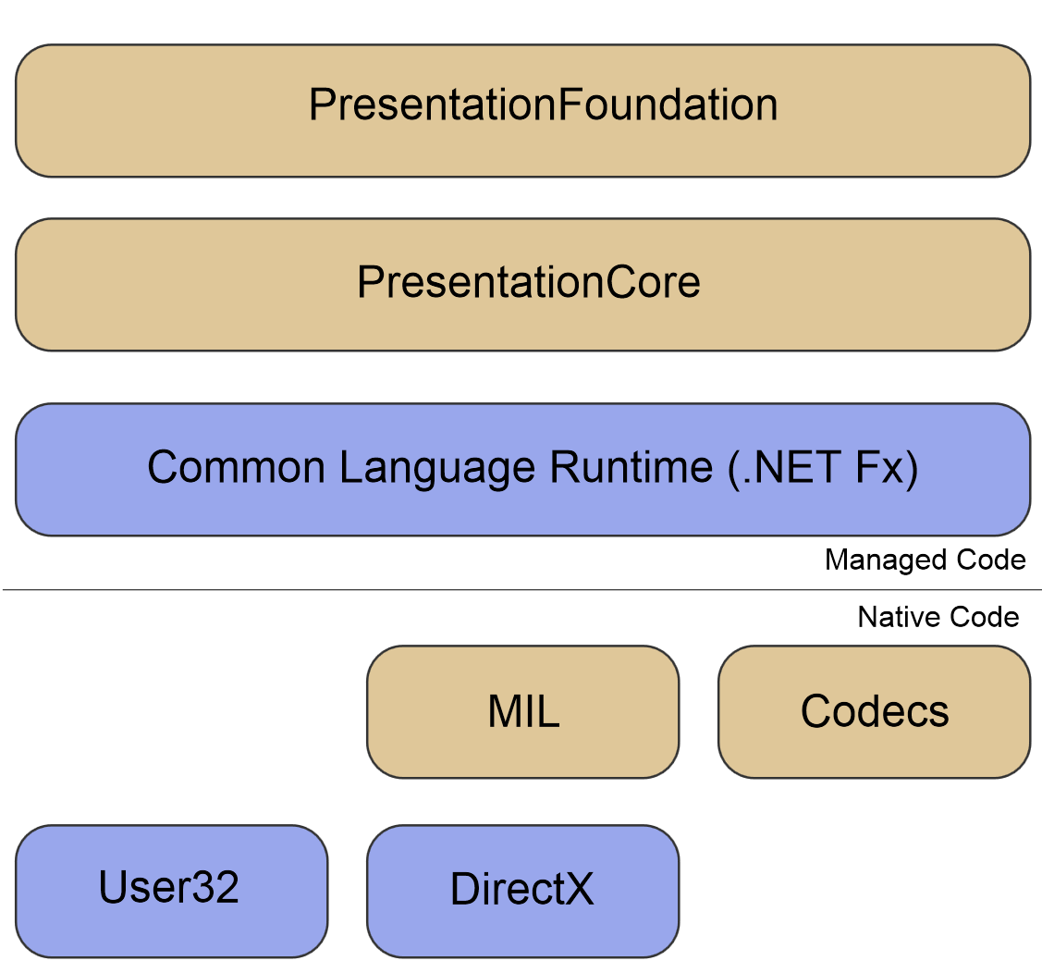
Windows Presentation Foundation (Cont.)
More specifically

Slide 13
XP vs. Vista vs. 7
You may wonder why things went from being great in XP to terrible in Vista to great in 7
Windows Vista
Windows Vista represented the first in some very long steps in developing a more stable Windows. Over the 7 years of its development it went through an entire overhaul – nearly every subsection of code was modified
One of those steps was the introduction of .NET and WPF
Vistas version of WPF is exactly as it is today, but all other rendering engines were deprecated and moved into ‘Software Emulation’ mode to maintain compatibility.
The reason Vista ‘feels slow’ is that every old application that wasn’t using WPF was now being rendered in emulation mode significantly degrading performance
In Windows 7 … GDI and WinForms are once again run at the hardware level.

Slide 14
The MVC design pattern (again)
Model
Data Collections, ADO.NET, LINQ, etc --- everything we’ve been using for weeks
View
A new XML based language called XAML (zammel)
Controller
C# code behind identical to that seen in ASP.NET (that’s why started with ASP.NET)

Slide 15
XAML
ASP uses HTML as its layout and rendering engine, WPF uses a new XML based language to define its GUI to separate Logic and Design (or V from C)
… lets take a look

